Slide 1
Topics to be covered
Counting
  Basic Principles
    Multiplication
    Addition
  Permutations
  Combinations

Slide 2
Basic principles
Multiplication principle
If an activity can be performed in k successive steps,
  Step 1 can be done in n₁ ways
  Step 2 can be done in n₂ ways
  …
  Step k can be done in n_{k} ways
Then: the number of different ways that the
activity can be performed is the product
n₁ ˣ n₂ ˣ n₃ ˣ … ˣ n_{k}

Slide 3
Multiplication Rule Example 1(a)
How many strings of length 4 can be formed using the letters ABCDE if repetitions are not allowed?
Solution: (four steps)
How many ways to choose the first letter?
How many ways to choose the second letter?
How many ways to choose the third letter?
How many ways to choose the fourth letter?
5
4
3
2

Slide 4
Multiplication Rule Example 1(a)
By Multiplication principle
  5*4*3*2 = 120
  120 Strings of length 4 may be formed
  from the string ABCDE.

Slide 5
Multiplication Rule Example 1(b)
How many strings of part (a) begin with the letter B?
Solution: (four steps)
How many ways to choose the first letter?
How many ways to choose the second letter?
How many ways to choose the third letter?
How many ways to choose the fourth letter?
1
4
3
2

Slide 6
Multiplication Rule Example 1(b)
By multiplication principle
1*4*3*2 = 24
24 strings begin with the letter B.

Slide 7
Multiplication Rule Example 2
In a digital picture we wish to encode the amount of light at each point as an eight bit string. How many values are possible at one point?
Solution: (eight steps)
How many ways are there to select a bit?
therefore using multiplication rule?
2*2*2*2*2*2*2*2 = 2⁸=256
2
x

Slide 8
Theorem
A set {x₁,x₂,…,x_{n}} containing n elements has 2^{n} subsets.
Proof: (using multiplication rule )
A subset can be constructed in n successive steps:
Pick or do not Pick x₁;
Pick or do not pick x_{2;}
…;
Pick or do not pick x_{n.}
Each step can be done in two ways. Thus the number of possible subsets is
2*2*…*2 = 2^{n}
n
2
2
.
.
2

Slide 9
Addition principle
Basic principles
Suppose that X₁, X₂, …, X_{t} are sets
and that the i^{th} set X_{i} has n_{i} elements.
If { X₁, X₂, …, X_{t} } is a pairwise disjoint family
i.e if i ≠ j, X_{i} ∩ X_{j} = ᵠ
Then: the number of possible elements that can be selected from X₁ or X₂ or … or X_{t} is
n₁ + n₂ + n₃ + … + n_{t}

Slide 10
Addition Rule Example 1
How many eight-bit strings either begin with 101 or 111?
Solution:
How many begin with 101?
How many begin with 111?
Then use addition
Therefore
there are 2⁵+2⁵ = 32+32 = 64 eight-bit strings that begin with either 101 or 111.
1ˣ1ˣ1ˣ2ˣ2ˣ2ˣ2ˣ2
=2⁵
1ˣ1ˣ1ˣ2ˣ2ˣ2ˣ2ˣ2
=2⁵
+

Slide 11
Addition Rule Example 2
In how many ways can we select two books from different subjects among five distinct computer science books, three distinct mathematics books and two distinct art books?

Slide 12
Addition Rule Example 2
Solution:
Computer Science - 5 distinct books
Mathematics - 3 distinct books
Arts - 2 distinct books
We could select 1 book from Computer science and 1 book from Mathematics.
How many ways could we do this?
How many ways could we select 1 book from Computer science and 1 book from Arts?
How many ways could we select 1 book from Mathematics and 1 book from Arts?
5*3 = 15
5*2 = 10
3*2 = 6

Slide 13
Addition Rule Example 2
Using Addition rule
15+10+6 = 31
ways of selecting two book from different subjects (among 5 distinct computer science books, 3 distinct mathematics books and 2 distinct art books).

Slide 14
Permutations
A permutation of n distinct elements x₁, x₂, …, x_{n} is an ordering of the n elements.
There are n! permutations of n elements.
Example:
There are 3! = 3 x 2 x 1 = 6 permutations of three elements a, b, c:
abc
bac
cab
acb
bca
cba

Slide 15
Permutations Example
How many permutations of the letters ABCDEF contain the substring DEF?
Solution:
DEF must be kept in this order and so should be treated as one token.
So we have
4 parts
A
B
C
DEF

Slide 16
Permutations Example
How many permutations of the letters ABCDEF contain the substring DEF?
Solution:
As DEF is treated as one token.
There are four steps
How many ways to choose the first letter?
How many ways to choose the second letter?
How many ways to choose the third?
How many ways to choose the fourth?
4
3
2
1

Slide 17
Permutations Example
How many permutations of the letters ABCDEF contain the substring DEF?
Solution:
There are 4 x 3 x 2 x 1 or 4! Permutations of the letters ABCDEF containing the substring DEF.

Slide 18
r-permutations
An r-permutation of n distinct elements is an ordering of an r-element subset of the n elements x₁, x₂,…, x_{n}
Examples of 2-permutations of a, b, c are
Other examples are
ab
ba
ca
ac
bc
cb

Slide 19
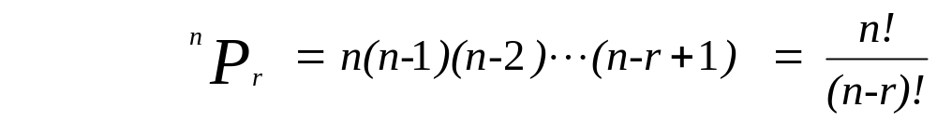
Theorem
r-permutations
For r < n
the number of r-permutations of a set with n distinct objects is
may be written as
^{n}P_{r} or _{n}P_{r} or P(n.r)

Slide 20
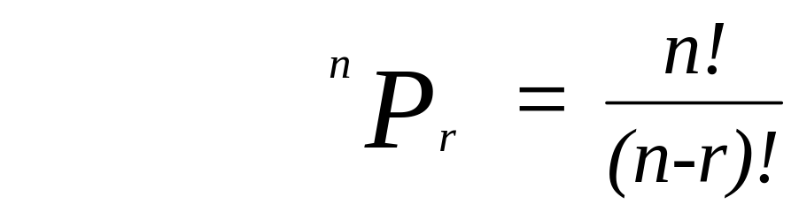
Theorem
r-permutations
Example:
Let X = {a, b, c}. How many subsets of X are of cardinality (or number of elements) of 2?
Solution (without formula) is 6:
Solution (using the formula) is 6:
³P₂ or P(3, 2) = 3*2 = 6
there are 6 subsets of X with cardinality 2.
ab
ba
ca
ac
bc
cb

Slide 21

Combinations
Let X = {x₁, x₂,…, x_{n}} be a set containing n
distinct elements
An r-combination of X is an unordered selection of r distinct elements of X,
for r < n
The number of r-combinations of set of n distinct elements is denoted

Slide 22
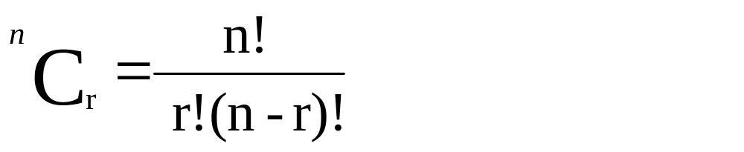
Combinations
The number of r-combinations of X is called the binomial coefficient
The formula

Slide 23
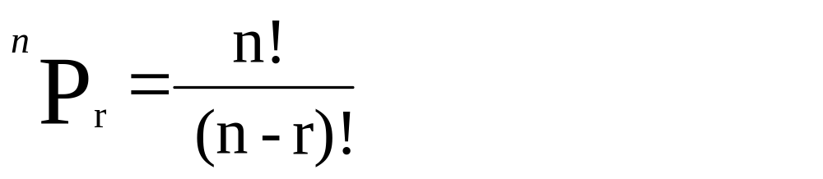
Permutations / Combinations Formula Differences
r-permutations
r-combinations
Which value is less and why?
  r-combinations as it has a greater denominator

Slide 24
Combinations Example
A group of students, Mary, Angel, Boris, Rosa, and Neil, has decided to talk with the math department chairperson about having the department offer more courses in discrete math. The chairperson said she will speak with three of the students.
In how many ways can these five students choose three persons, from their group, to talk with the chairperson?
Solution:
[Recognize that students are distinct, and order is not important.]

Slide 25
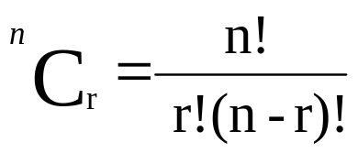
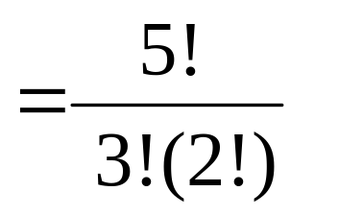
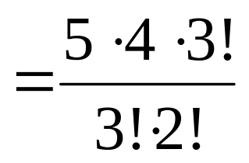
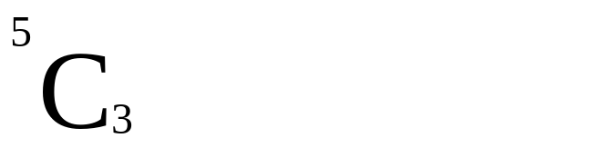


Combinations Example
In how many ways can these five students choose three persons, from their group, to talk with the chairperson?
Solution:
[As distinct, and order is not important.]
[Combinations is considered]

Slide 26
Combinations with repetition
Example – How many strings can be formed using the letters MISSISSIPPI
Solution
[Consider We have 11 positions to place letters.]
_ _ _ _ _ _ _ _ _ _ _
1 2 3 4 5 6 7 8 9 10 11
[We have to place the 1 M, 4 I, 4 S, and 2 P. ]

Slide 27
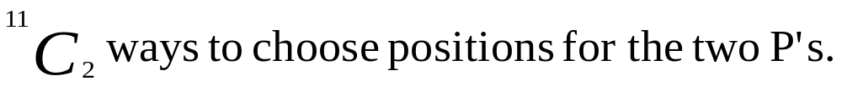
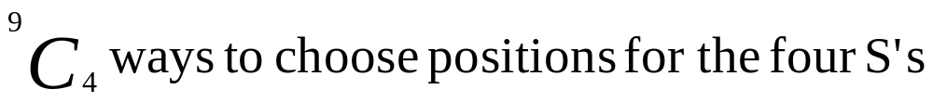
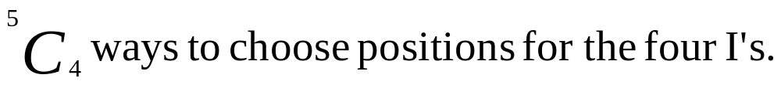
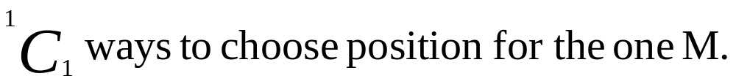
Combinations with repetition
Example – How many strings can be formed using the letters MISSISSIPPI
Solution [Any letter(s) can be placed 1st, 2nd, etc.]
[To place the 2 P’s in any of the 11 places]
[To place the 4 S’s in any of the remaining 9 places]
[To place the 4 I’s in any of the remaining 5 places]
[To place the 1 M in the remaining 1 place]

Slide 28
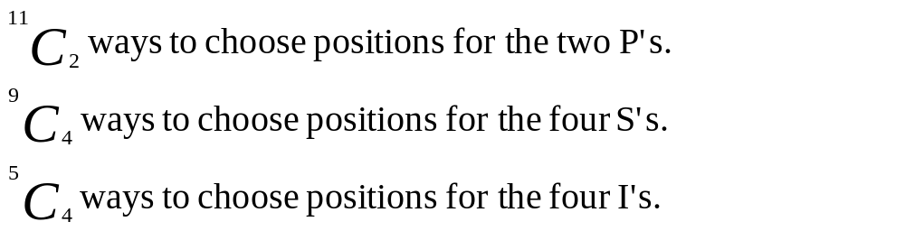

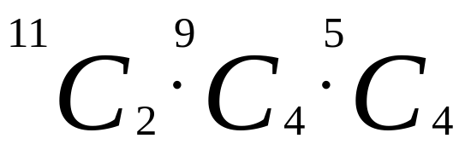
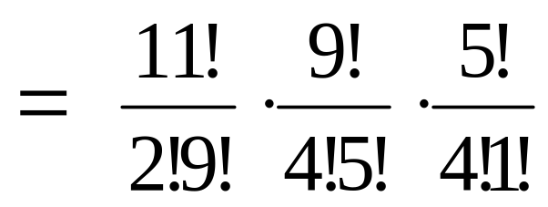
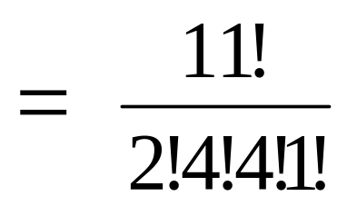
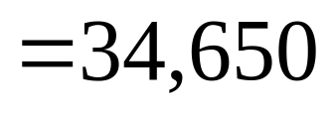
Ordering with repetition
Example – How many strings can be formed using the letters MISSISSIPPI
Solution

Slide 29
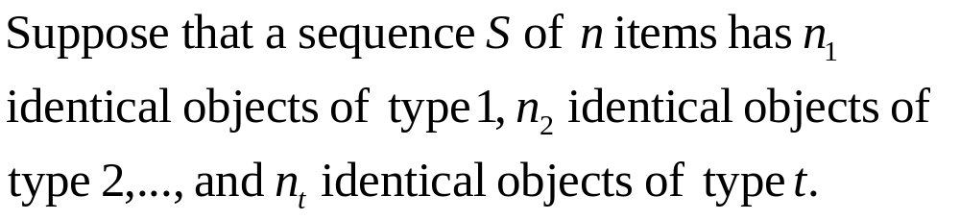
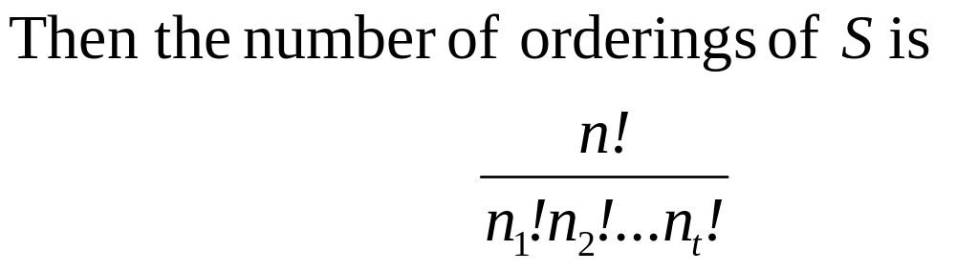
Theorem
Ordering with repetitions

Slide 30
Non-ordering with repetition
Consider three books: a computer science book, a physics book and a History book. Suppose that the library has at least six copies of each of these books. In how many ways can we select six books?
Solution
[Consider We have 6 books to be selected.]
_ _ _ _ _ _
1 2 3 4 5 6
[We have three types of books - C, P, H.]
[To separate the types of books, we need 2 markers]
| |

Slide 31
Non-ordering with repetition
Solution
[The markers may be placed anywhere amidst the 6 books.] e.g. _ _ _ | _ | _ _
such as C C C | P | H H
or C C | P P | H H
or | P P P P | H H
or C C C | P P P |
or | | H H H H H H

Slide 32
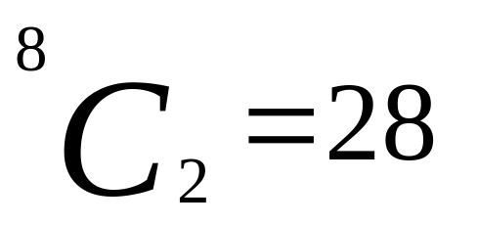
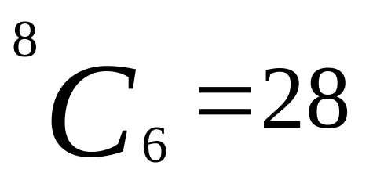
Non-ordering with repetition
Consider three books: a computer science book, a physics book and a History book. Suppose that the library has at least six copies of each of these books. In how many ways can we select six books?
Solution
[Therefore, we have 6 books to be selected, and 2 (or 3-1) markers to separate the types.]
_ _ _ | _ | _ _
1 2 3 4 5 6 7 8
We place either the markers or the books
or

Slide 33
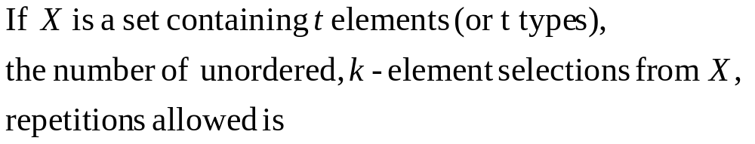
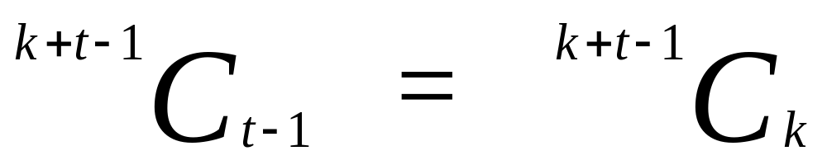
Theorem
Non-ordering with repetitions

Slide 34
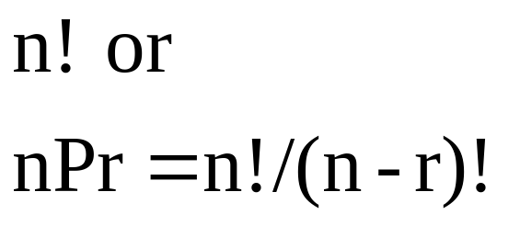
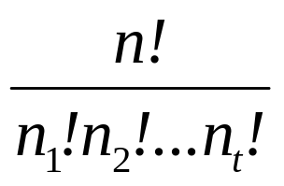

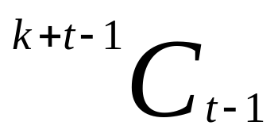
IN SUMMARY
Counting by Basic Principles
or
No repetitions
Repetitions
Ordered
Unordered

Slide 35
Other Considerations
9 students on one side of a table
9! = 362880
9 students around a table
(9-1)! = 40320

Slide 36
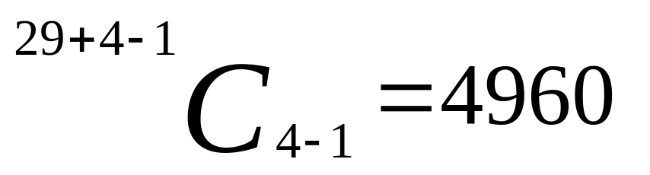
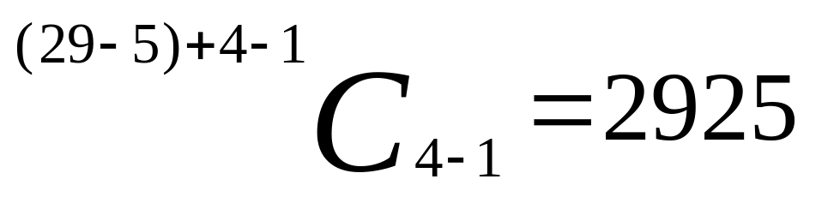
Other Considerations
x₁ + x₂ + x₃ + x₄ = 29
x₁≥0, x₂≥0, x₃≥0, x₄ ≥0
x₁ + x₂ + x₃ + x₄ = 29
x₁>0, x₂≥1, x₃>2, x₄ ≥0

Slide 37
Topics to be covered
Permutations
Combinations

